Slide 1








WEB SERVER REQUEST MONITOR

Slide 2
Project Overview
This system monitors server performance in real-time, tracking CPU, memory, requests, and response times. It provides an easy-to-use dashboard for quick analysis and problem-solving.

Slide 3
Problem statement
Web servers face issues like high usage and slow responses. Without monitoring, these problems are hard to detect, leading to inefficiency and downtime.
PROPOSED SOLUTION
➢Tracks CPU, memory, and HTTP requests in real-time.
➢Logs requests and responses for analysis.
➢Provides a user-friendly dashboard for server health visualization.

Slide 4
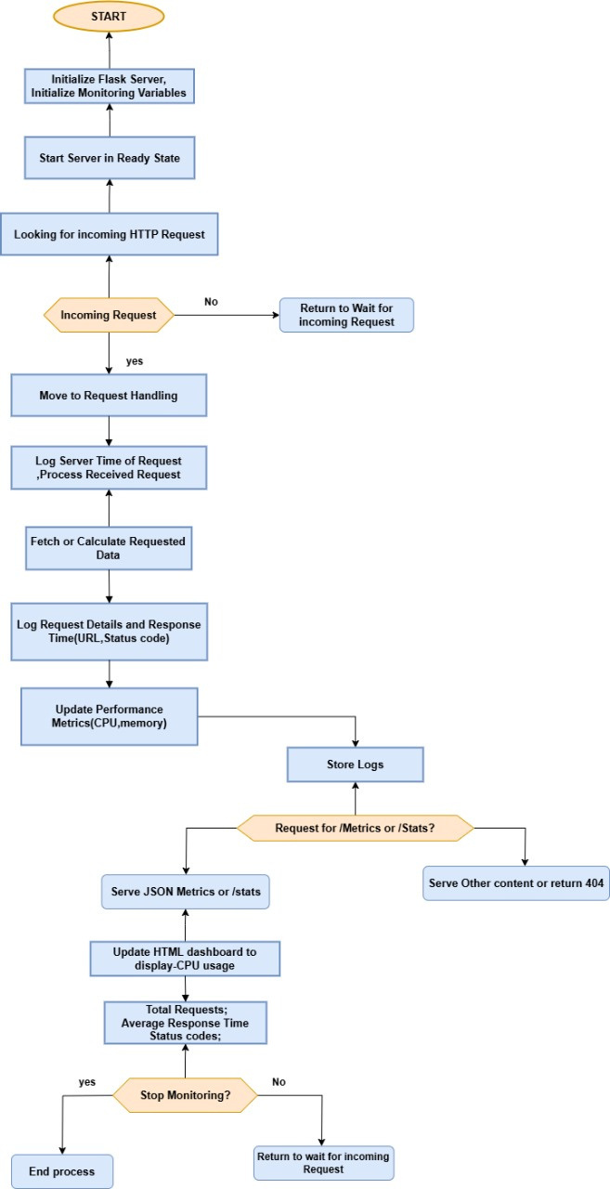
METHODOLOGY
1. Components:
○ app.py: Handles HTTP requests, data processing, and dashboard.
○ monitor.py: Tracks performance and logs requests.
2. Key Features:
○ Real-time performance metrics using psutil.
○ Logs HTTP requests (method, URL, status, response time).
3.Control Flow:

Slide 5
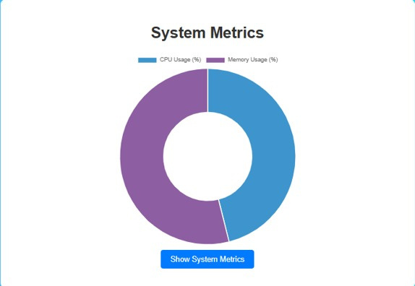
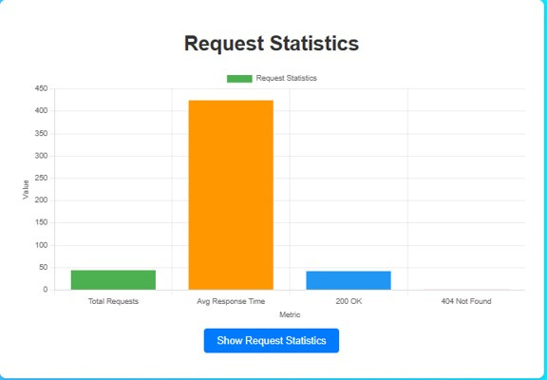
RESULTS
➢Tracks and logs CPU, memory, and requests.
➢Provides real-time JSON metrics and a dashboard for analysis.

Slide 6
FUTURE SCOPE
➢Include metrics like disk usage and network activity.
➢Monitor multiple servers.
➢Add alerts for high resource usage and predictive analytics
using AI.

Slide 7
CONCLUSION
The Web Server Monitoring System efficiently tracks server performance in real-time with a user-friendly dashboard for proactive management. Built with Python, Flask, and psutil, it offers scalability to meet evolving server needs.

